Slide 1
IS 120
Last Day of Class

Slide 2
Before Smash Bros...
Announcements
Project 3
Reflect on the semester
Watch a video
Smash Bros

Slide 3
Announcements
End of Semester One-on-Ones Tomorrow (TNRB W223)
Final Project due April 22nd
  Keep it simple, but show off what you’ve learned

Slide 4
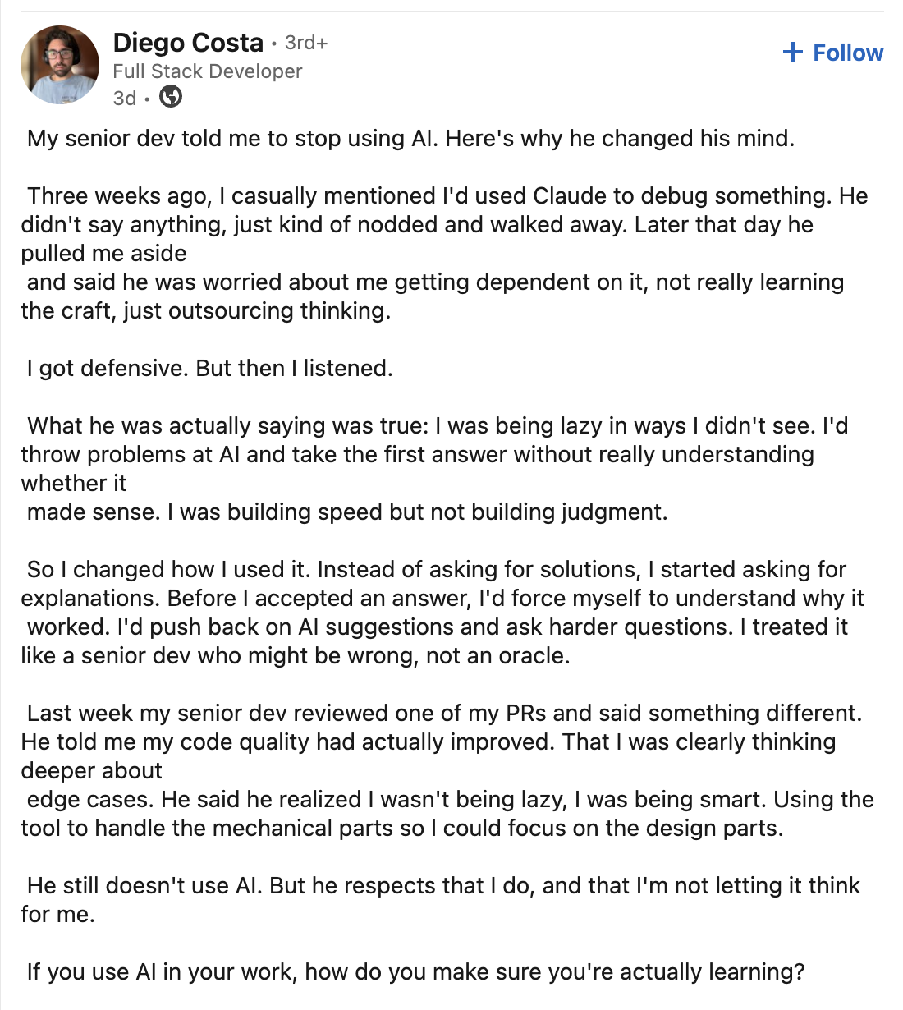

Slide 5
How was Supabase?
Did you think it was worth learning?
Would you change anything?

Slide 6
Things We Covered in This Class
HTML structure, HTML tags, semantic HTML, HTML attributes, classes and ids, Chrome Dev Tools, Git/GitHub, web design principles, CSS selectors, CSS properties, box model, display, position, pseudo classes and elements, flexbox, grid, media queries, mobile-first design, transitions, animations, CSS variables, web accessibility, JavaScript syntax, variables, data types, DOM manipulation, HTML input, functions, event handling, debugging, console, operators, conditionals, loops, arrays, objects, JSON, local storage, APIs, fetch, await/async, API keys, error handling, Supabase functions .

Slide 7
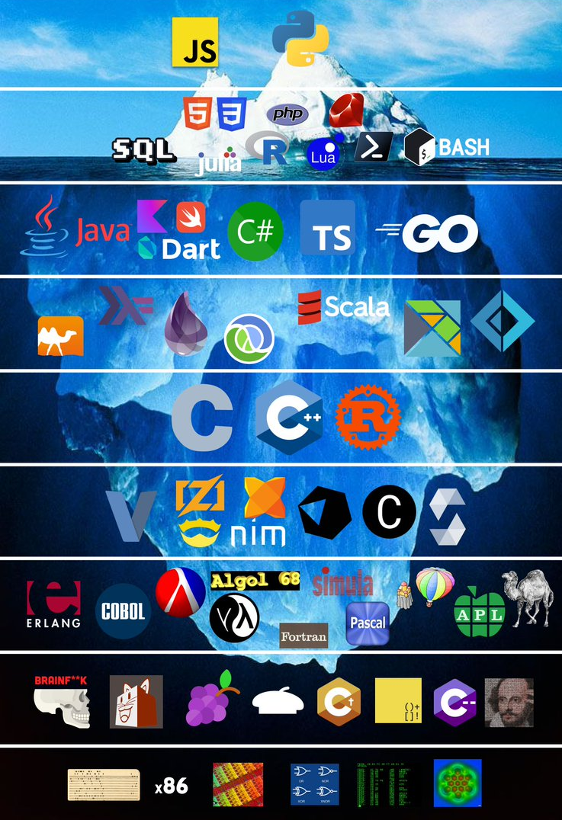

Slide 8
Problem Solving
BYU Sorensen Center for Moral and Ethical Leadership
People are naturally creative, resourceful, and whole
Used as a mindset for life coaches to view clients
Trusting that people have the ability to solve their problems

Slide 9
Problem Solving
People are naturally creative, resourceful, and whole
This is also a great way to look at your own problems
Doesn’t mean you can’t go to other people for help
You’re better equipped to solve your problems than anyone else

Slide 10
Problem Solving
Close your eyes, take a deep breath, and say it with me...
I am naturally creative, resourceful, and whole
I can solve my own problems

Slide 11
Think like a Programmer
Understand the problem
Break it down
Just start coding something, even if it’s bad
Try Research
Repeat

Slide 12
Hyperplexed Videos
Recreating Designs
  https://youtu.be/GHZBa_R93ag (first 2 mins)
Mouse Movement Animation
  https://youtu.be/G9207EJySaA

Slide 13
Contact Info
(435) 503-6131
tmanatkin@gmail.com
linkedin.com/in/tanneratkin/

Slide 14
Class Photo

Slide 15
Smash Bros

